Slide 1
ToDo
Implementing automated global variable reinitialization for AFL++ persistent mode (On-going)
Using LLVM pass that provides analysis APIs for global variables
Comparing fuzzing speed and crash detection ability of AFL++ normal mode and that of persistent mode
On programs with known crashes
With address sanitizer or without address sanitizer
Developing (ideas for) automated deferred initialization and shared memory test cases

Slide 2
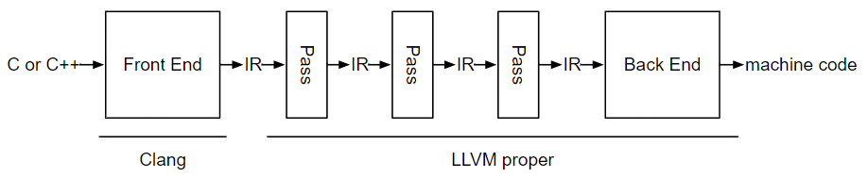
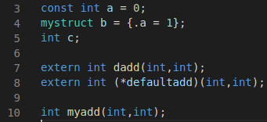
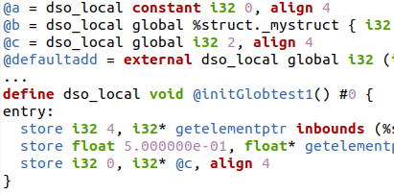

Reinitializer Implementation Overview
Using LLVM pass to instrument target program
Instrumenting IR directly instead of analyzing IR and generating code, which I attempted last week
Global variables
Inserted definition of the initialization function

Slide 3

Difficulty of Generating Initializer as Code using LLVM Pass Analysis
Impossible to identify member variable name of a structure type
which makes code generation difficult
mystruct s = {.a=1,.b=0.5};
…
s.? = 1;
float temp = 0.5;
memcopy((void*)&s+?,&temp,sizeof(float));
Code:
Need member names to assign a value again
IR:
llvm does not maintain the member variable name
memcopy is an option but need header inclusion, temporary variable, and offset consideration which are language dependent
So, instrumenting IR directly for reinitializer is easier and clearer!

Slide 4
Issues in IR Instrumentation-based Reinitializer
Which modules are used or un-used in a target program if we have multiple modules (i.e., source files)?
How the main function of a target program recognize initializer functions in different modules?
Obtainable from developer written build configuration files (Makefile)
obj1.c
compile
pass
obj1.o
main.o uses which module?
if it uses obj1.o, how it recognize the initializer function of obj1.o?
obj2.c
compile
pass
obj2.o
?
main.c
compile
pass
main.o
Recognizable after linking
Modules with initializer function

Slide 5
Compiler-embedded Link Time Optimization (LTO) Pass
Compiler-embedded implementation of the reinitializer for compatibility to existing build systems such as Makefile
Using LTO pass to execute the pass after the linking
afl-clang-fast
(clang)
InsertInitializerPass (InitP)
InsertInitToMainPass (MainP)
LTO pass
obj1.c
compile
InitP
obj1.o
link
Makefile
obj2.c
compile
InitP
obj2.o
main.link.o
MainP
target
executable
main.c
compile
InitP
main.o

Slide 6
Current Implementation Status
Implementing and embedding InsertInitializerPass to clang : done
Embedding InsertInitToMainPass to clang (afl-clang-fast) : on-going

Slide 7
Next ToDo
Implementing automated global variable reinitialization for AFL++ persistent mode
Using LLVM pass that provides analysis APIs for global variables
Comparing fuzzing speed and crash detection ability of AFL++ normal mode and that of persistent mode
On programs with known crashes
With address sanitizer or without address sanitizer
Developing (ideas for) automated deferred initialization and shared memory test cases

